Slide 1




TITLE PAGE
•Problem Statement Title – Student Innovation.
•Theme –AI Mock Interview Chatbot.
•Team ID –T27
•Team Name –Vision Crafters
•Participant Names –Koushik Edla
Gowtham Oja
Venu Konda
Sri Indu College of Engg & Tech - Cyber Club, Department of Cyber Security
Page 01

Slide 2

Vision Crafters
IDEA TITLE
Proposed Solution (Describe your Idea / Solution / Prototype)
•A web app that generates personalized interview questions using AI based on user inputs like job role, experience, tech stack, and question type.
• Helps users prepare effectively by providing tailored technical and behavioral questions, removing the need for manual search.
•Uses Google’s Gemini AI for real-time question generation
Stores data in Firebase FirestoreCustom
Setbuilt with Next.js + TailwindCSS for scalability and performance
Sri Indu College of Engg & Tech - Cyber Club, Department of Cyber Security
Page 02

Slide 3
Vision Crafters
TECHNICAL APPROACH
•Tech Stack:
Frontend: Next.js, TailwindCSS.
Backend/API: Node.js (Next.js API Routes).
AI Model: Gemini 2.0 Flash (Google), Vapi AI(Voice agent).
Database: Firebase Firestore.
UI/UX: TailwindCSS, Mona Sans, Sonner Toaste
Sri Indu College of Engg & Tech - Cyber Club, Department of Cyber Security
Page 03

Slide 4
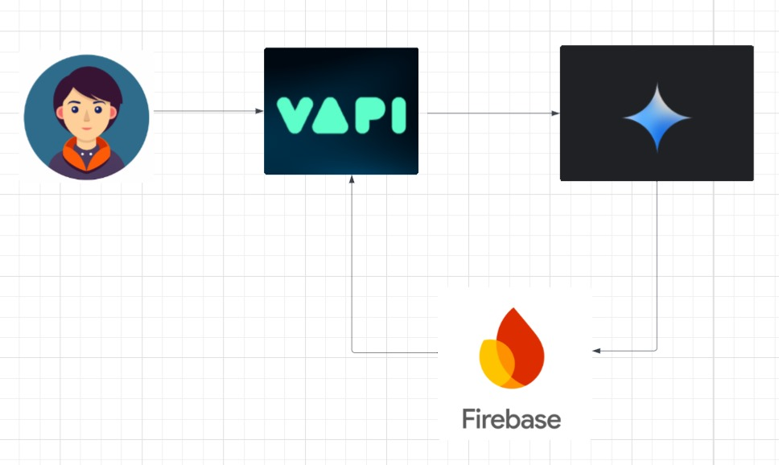
Vision Crafters
TECHNICAL APPROACH
•Flow chart
Sri Indu College of Engg & Tech - Cyber Club, Department of Cyber Security
Page 03

Slide 5
Vision Crafters
FEASIBILITY AND VIABILITY
•Technically feasible using stable AI APIs and modern web tools
Firebase offers reliable and scalable backend support
Easy to deploy and maintain with minimal resources
•API cost or rate limits for AI usage.
Inaccurate or irrelevant AI-generated questions
User privacy and data handling concerns
•Optimize prompts to reduce API calls
Add feedback/rating system for question quality
Use Firebase Auth & Firestore rules for data security
Sri Indu College of Engg & Tech - Cyber Club, Department of Cyber Security
Page 04

Slide 6
Vision Crafters
IMPACT AND BENEFITS
•Target Audience Impact:
Helps job seekers prepare confidently with tailored questions
Saves time spent searching for relevant interview material
Increases chances of success in interviews
•Benefits:
Social: Empowers individuals with AI-driven preparation tools
Economic:Reduces need for paid coaching or mock interview services
Scalability: Can be extended for companies to screen candidates
Sri Indu College of Engg & Tech - Cyber Club, Department of Cyber Security
Page 05

Slide 7
RESEARCH AND REFERENCES
Vision Crafters
•RESEARCH & REFERENCES
Google AI – Gemini 2.0 API:
https://ai.google.dev
FirebaseDocumentation:
https://firebase.google.com/docs
Next.jsFramework:
https://nextjs.org/docs
TailwindCSS Styling Guide:
https://tailwindcss.com/docs
Sri Indu College of Engg & Tech - Cyber Club, Department of Cyber Security
Page 06

Slide 8
Vision Crafters
FUTURE ENHANCEMENTS
User Authentication: Add secure login and saved interview history.
Analytics Dashboard: Track progress and performance over time.
Answer Suggestions: Provide sample answers for generated questions.
Export Options: Download questions as PDF or share via email.
Multi-language Support: Enable interview prep in regional languages.
Feedback Loop: Use user ratings to improve AI-generated questions.
Sri Indu College of Engg & Tech - Cyber Club, Department of Cyber Security
Page 07

Slide 9
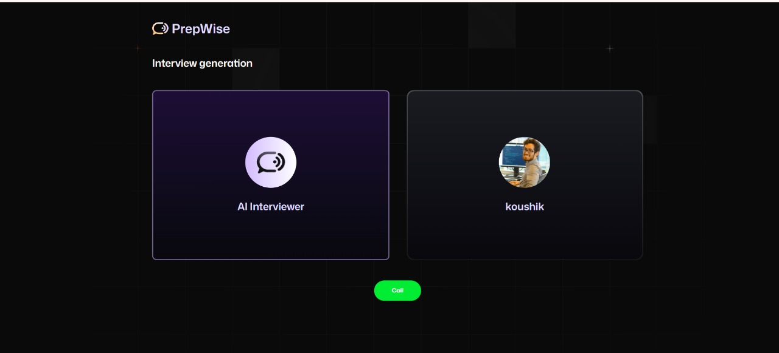
Vision Crafters
DEMO (IF APPLICABLE)
Demo link
Sri Indu College of Engg & Tech - Cyber Club, Department of Cyber Security
Page 08

Slide 10
Vision Crafters
CONCLUSION & THANK YOU
Project Summary:
This AI-powered interview question generator offers tailored questions based on user input, helping candidates prepare more effectively for interviews. With a user-friendly interface and scalable backend, it provides valuable support for job seekers.
A big thank you to the organizers, mentors, and everyone who supported this project. Your guidance and feedback have been invaluable!
Sri Indu College of Engg & Tech - Cyber Club, Department of Cyber Security
Page 09

Slide 11

IMPORTANT INSTRUCTIONS
Please ensure below pointers are met while submitting the Idea PPT:
1.Kindly keep the maximum slides limit up to six (9). ( Including the title slide)
2.Try to avoid paragraphs and post your idea in points /diagrams / Infographics /pictures.
3.Keep your explanation precise and easy to understand.
4.Idea should be unique and novel.
5.You can only use provided template for making the PPT without changing the idea details pointers (mentioned in previous slides).
Sri Indu College of Engg & Tech - Cyber Club, Department of Cyber Security

